Slide 1

Project 358
Customer Personality Analysis
Presented By: Krutika chougule

Slide 2
Problem Statement
Customer Personality Analysis is a detailed analysis of a company’s ideal customers. It helps a business to better understand its customers and makes it easier for them to modify products according to the specific needs, behaviours and concerns of different types of customers.
Customer personality analysis helps a business to modify its product based on its target customers from different types of customer segments. For example, instead of spending money to market a new product to every customer in the company’s database, a company can analyse which customer segment is most likely to buy the product and then market the product only on that particular segment.

Slide 3
objective
The Main Aim of project is to need perform Clustering to summarize customer segmentation

Slide 4


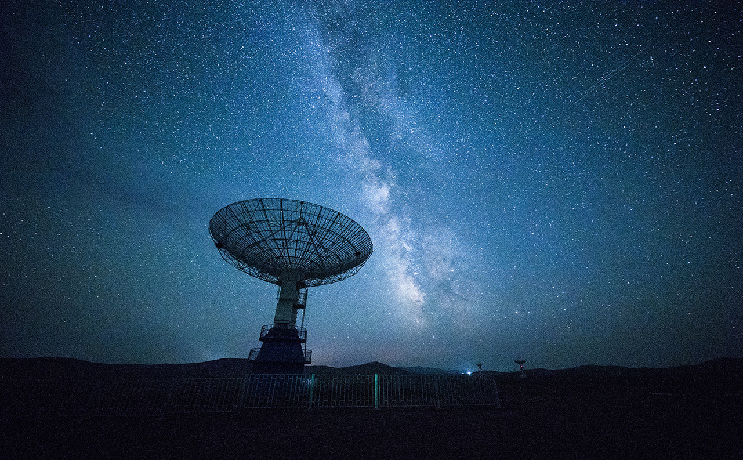
Project flow
Data Collection
EDA
Feature Engineering
Model Building And Evaluation
Model Deployment

Slide 5
Data Collection

Slide 6
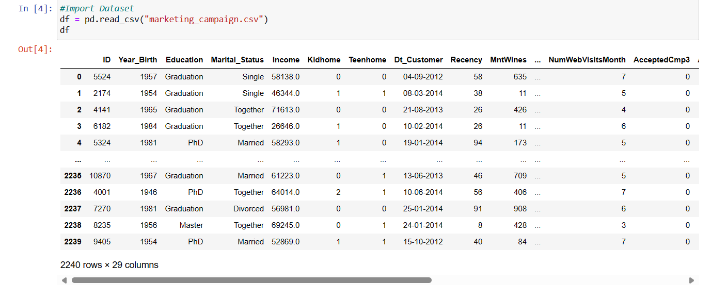
Load data in Python notebook by creating variable as df.

Slide 7
Exploratory Data Analysis
{EDA}

Slide 8
EDA
In EDA is a step to ensure the data is cleaned and ready for processing, providing insights and preventing errors

Slide 9
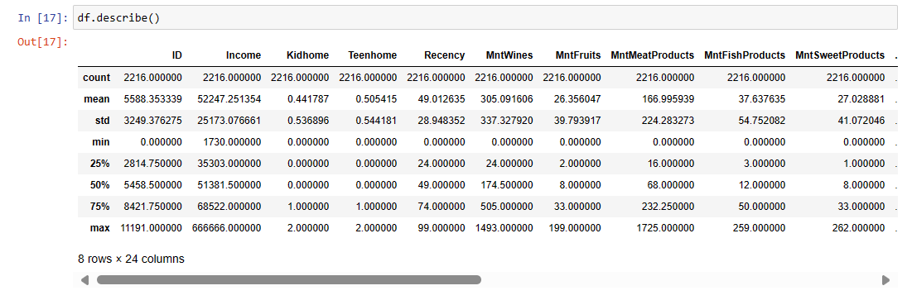
Basic description of the data set

Slide 10
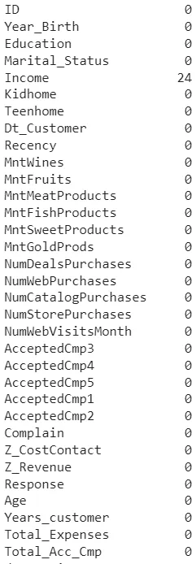
Checking a null Value

Slide 11
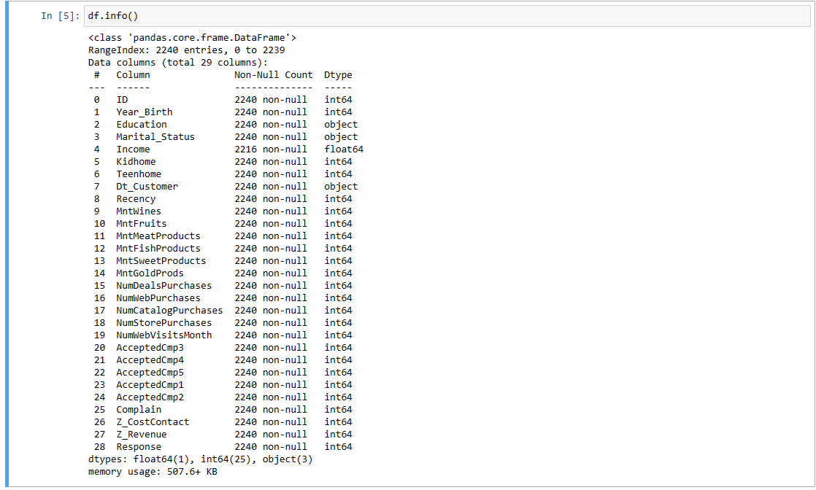
Checking a data types

Slide 12
Feature Engineering

Slide 13
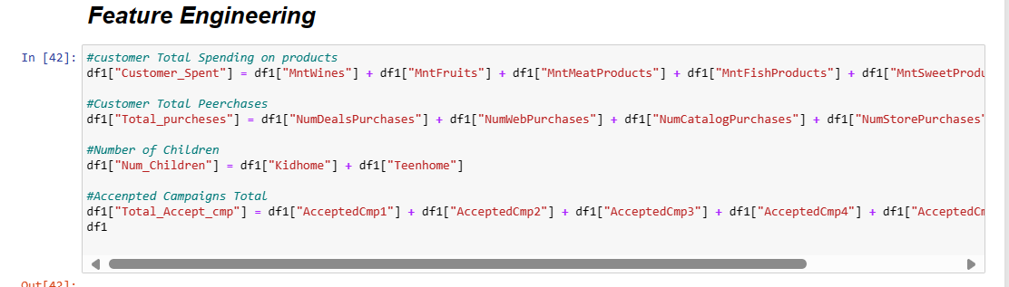

Slide 14
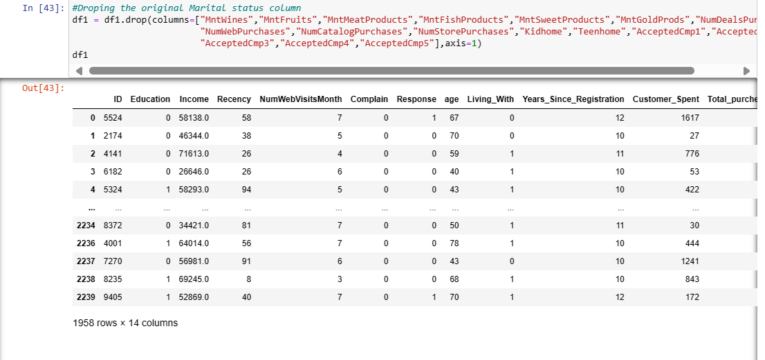
Drop a unnecessary Feature & drop a columns

Slide 15
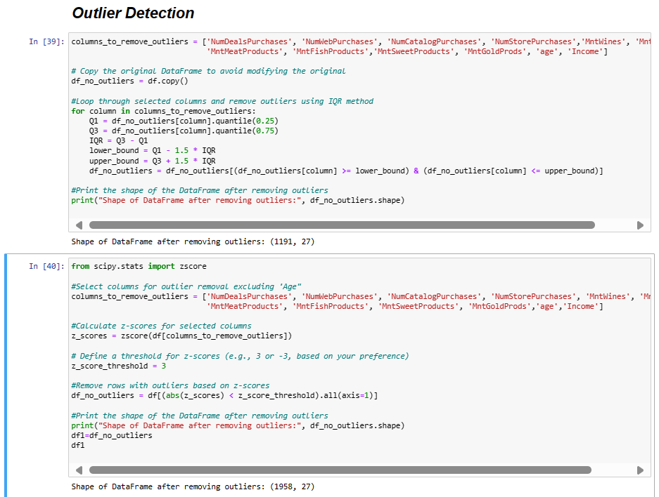
Outlier Detection

Slide 16
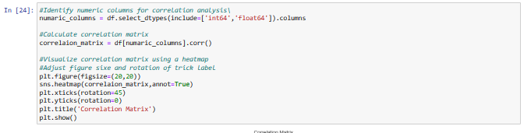
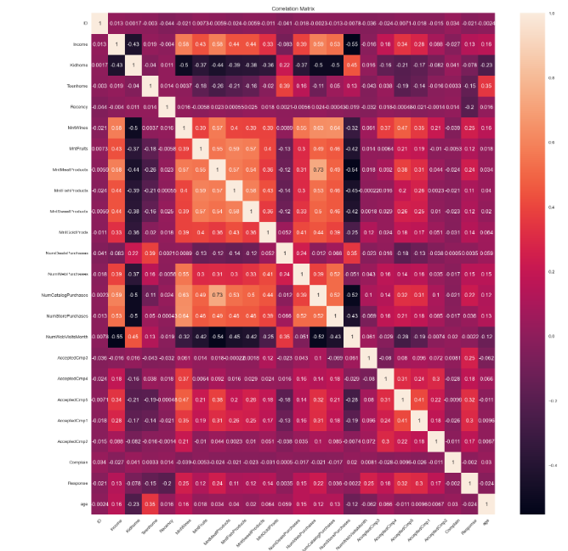

Slide 17
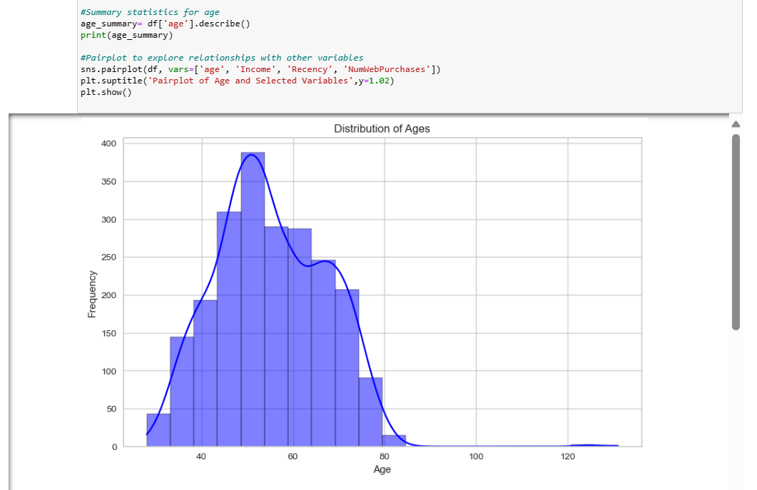

Slide 18
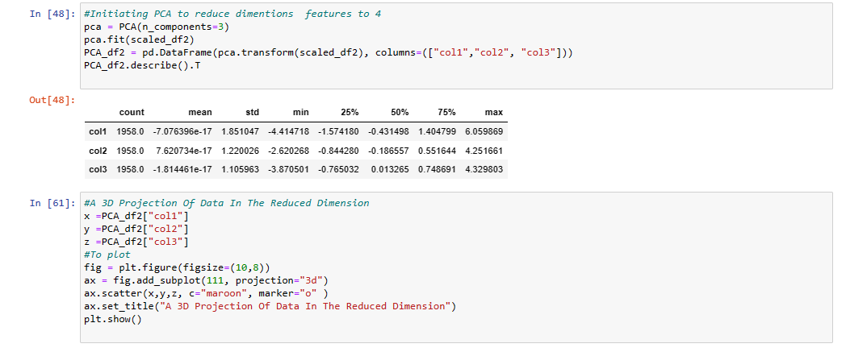
Dimensionality Reduction
Dimensionality Reduction using PCA

Slide 19
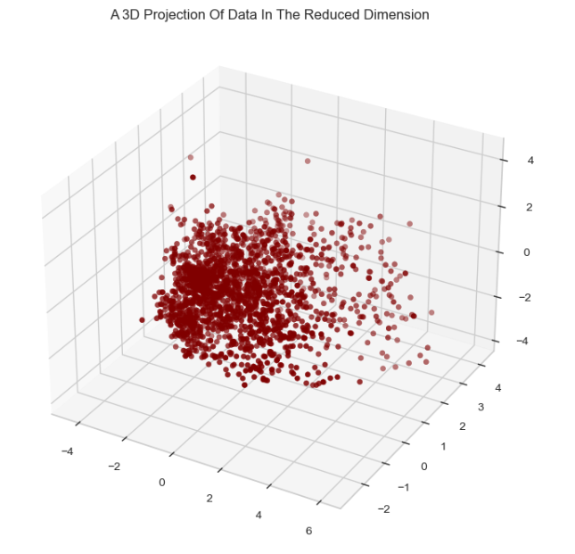

Slide 20
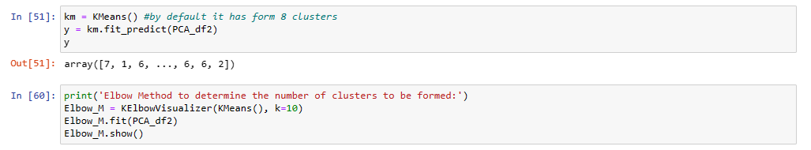
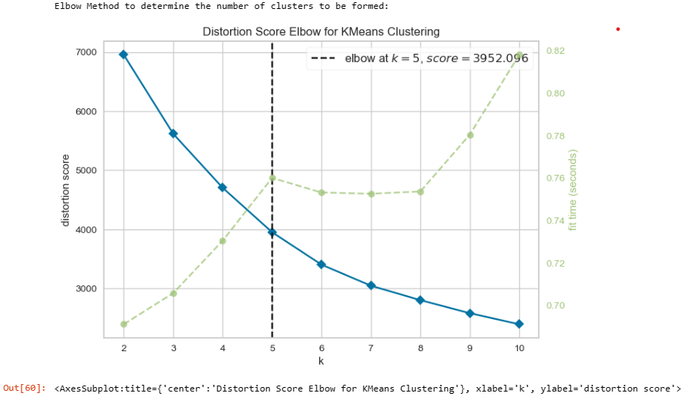
Clustering
In a given data we want to find a cluster by KMeans
In This way we got a 5 cluster
By KMeans method
cluster 0 high income low spend.
cluster 1 highest spent and highest earning.
cluster 2 low income low spend.
cluster 3 high income high spending.
cluster 4 lowest spent low income.

Slide 21
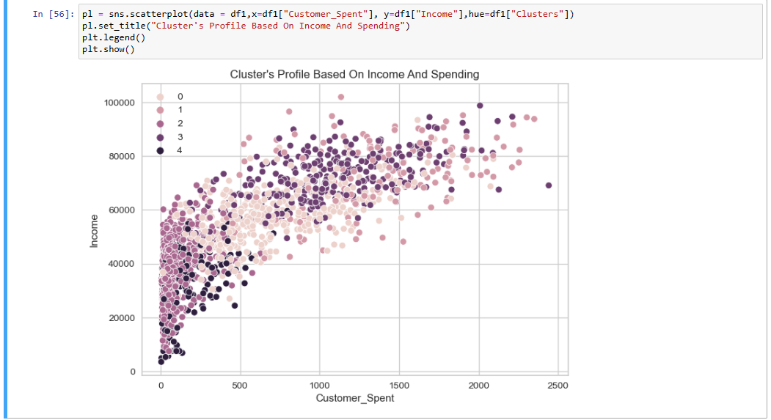

Slide 22
Model Building
and Evaluation

Slide 23
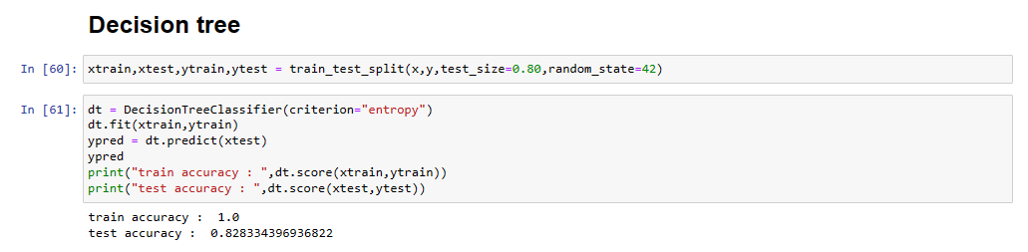
There Are 3 Types of models
1.Overfitted --> If training accuracy is very high and testing accuracy is very low (more than 3% of difference) it is overfitted model
2.Underfitted -->model is not able to perform good in training as well as testing it is an underfitted model
3.Generalized -->both training accuracy and testing accuracy is high (less than 3 difference between training and testing accuracy)
Decision Tree Using train_test_split(model validation technique)
This is overfitted model.

Slide 24
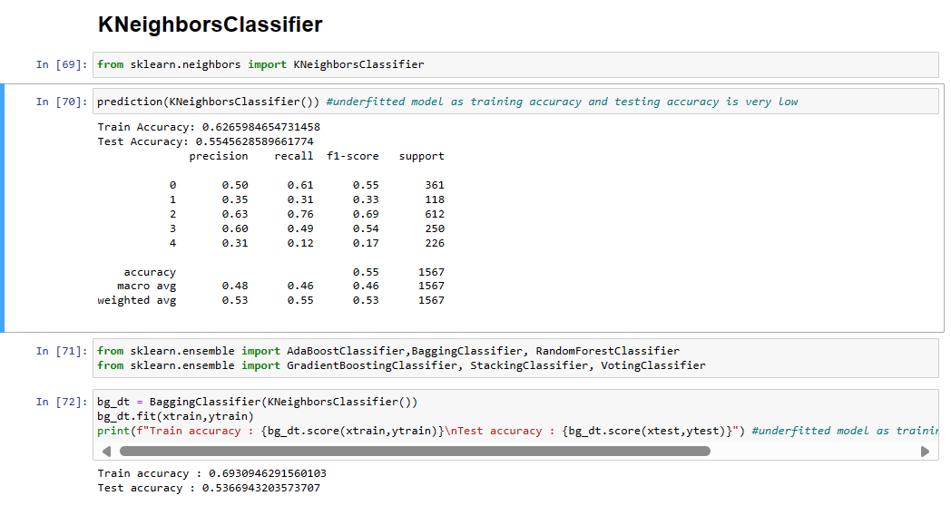
This is underfitted model.

Slide 25
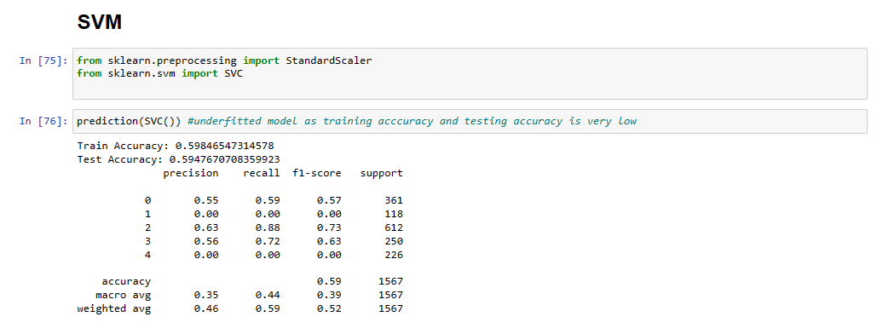
This is underfitted model.

Slide 26
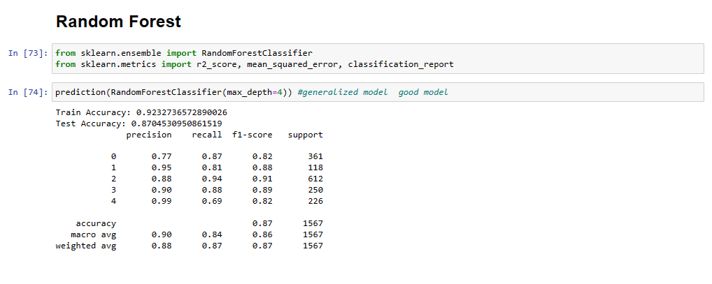
Random Forest
This is Generalized model.
Random forest is a best performing algorithm so we will use random forest algorithm.
Random Forest is our final model.

Slide 27
Model Deployment

Slide 28
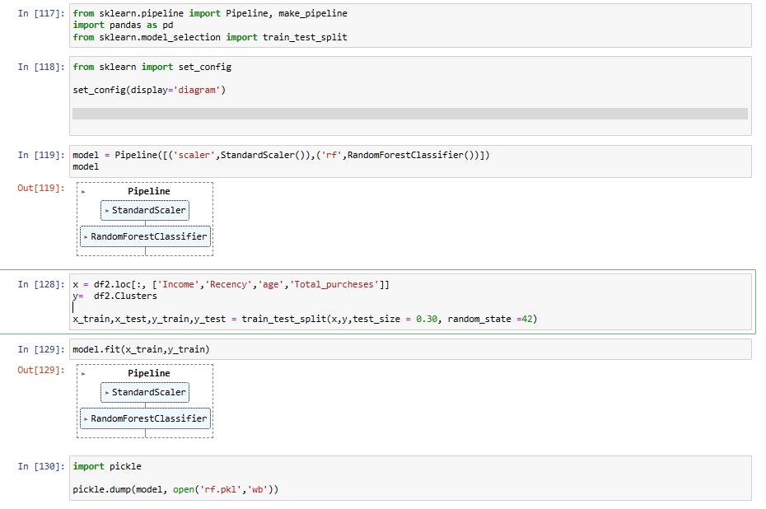
We create pipeline for deployment of our model.
We select 'Income','Recency','Customer_Age','Total_purcheses ‘ columns for input purpose
and cluster column for output purpose

Slide 29
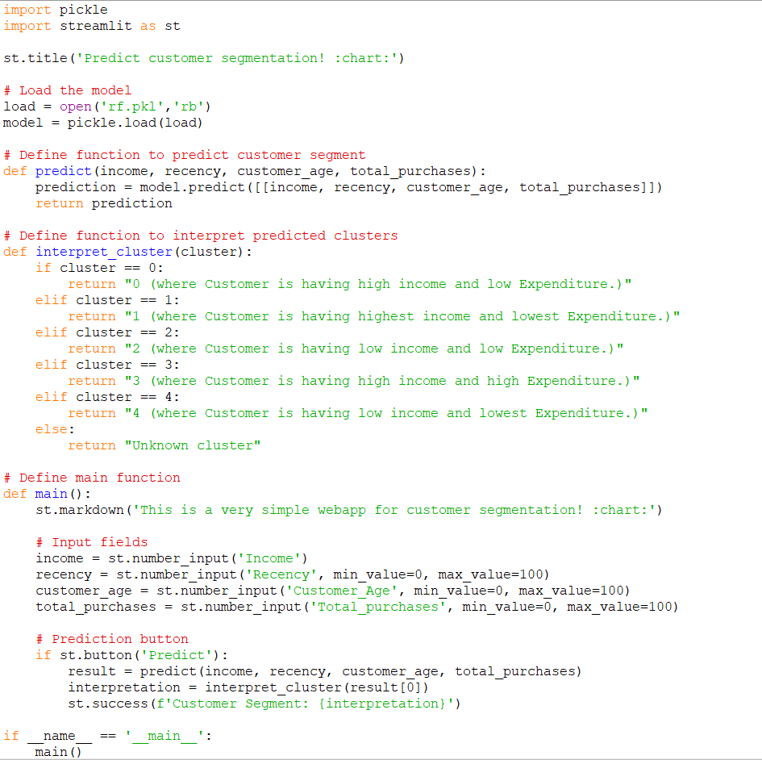
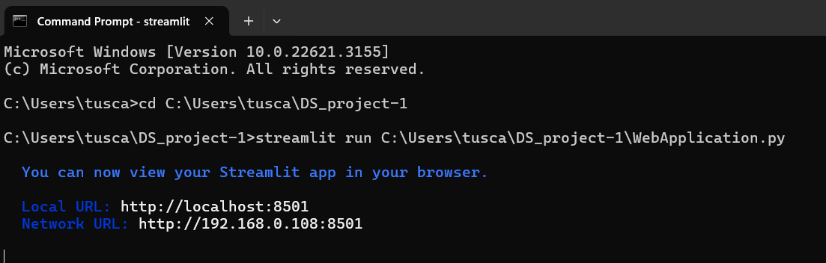
We used deployment in Streamlit

Slide 30
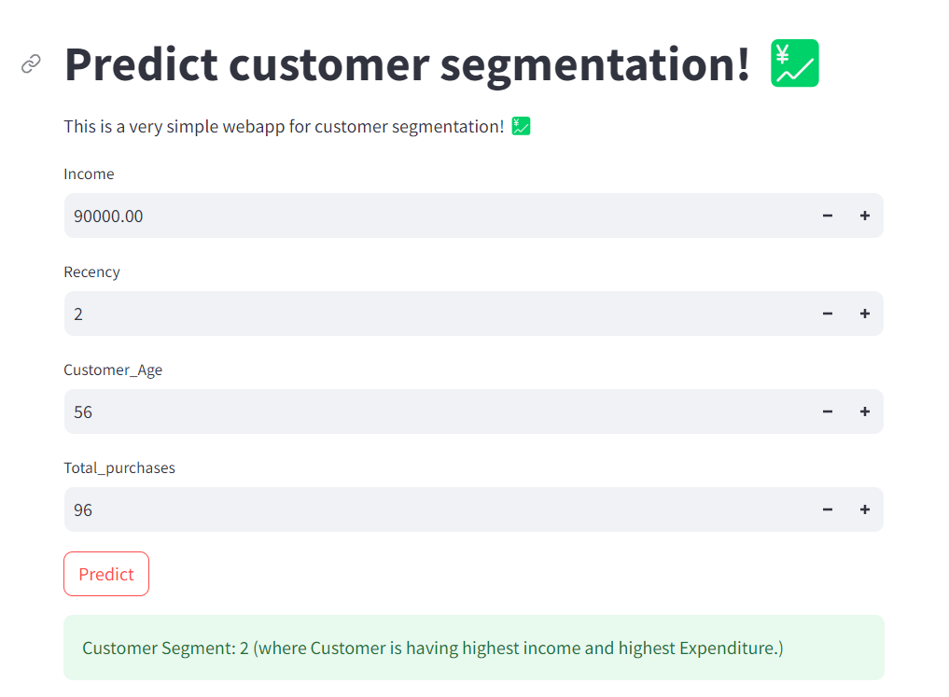
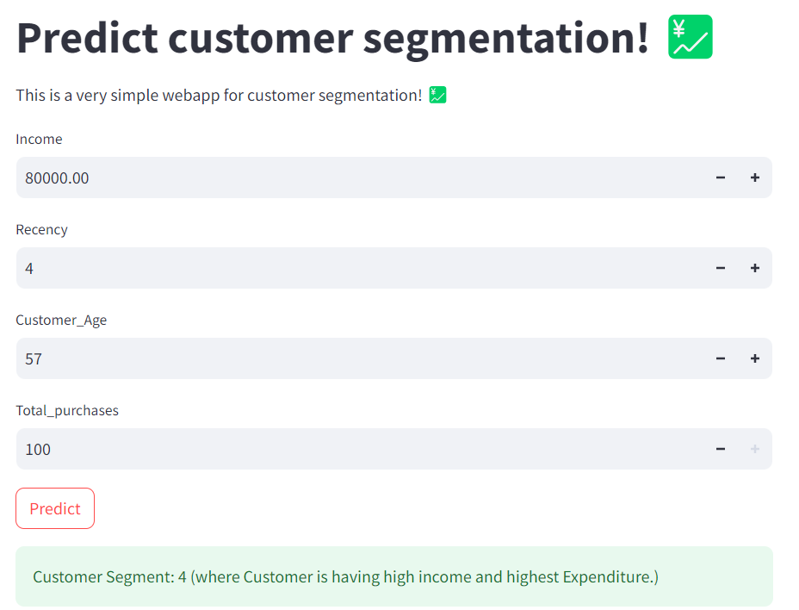
Highest income Highest Expenditure
High income Highest Expenditure

Slide 31
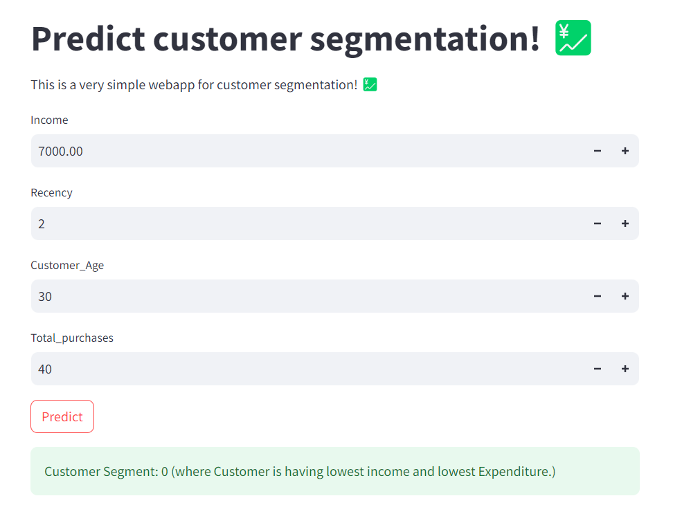
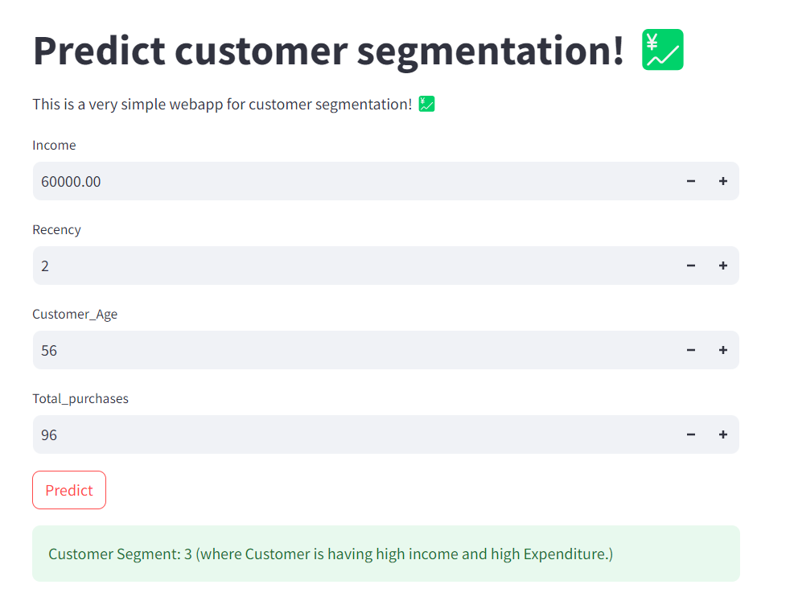
Lowest Income lowest Expenditure
High Income And high expenditure

Slide 32

Thank You!

